Slide 1

BUILT
TO
DAWN
KEEP BUILDING█ Design by in CIT
newenergycoder.club

Slide 2
BUILT
TO
DAWN
KEEP BUILDING█ Design by in CIT
newenergycoder.club

Slide 3
NEC架构图
产品组
运营
机械
电控
硬件
场务
视觉
Rcer
开源项目群
运营SIG
机构SIG
视觉SIG
CURC-ROBOCON
开发者
常州工NEC-ROBOCON战队
合作需求方
Sponsor
线下群
NEC 开发者社群
萝马车圈
全员群
项目群
NEC群
A416群
Gitee/Github
WeChat
Feishu
QQ
NEC-Claw

Slide 4
Vibe coding
WIN+R，cmd，
Ctrl+Alt+T{kimi}
KEEP BUILDING█ Design by in CIT
newenergycoder.club

Slide 5
WI-FI：A416
{code}:
A416A416A416
KEEP BUILDING█ Design by in CIT
newenergycoder.club

Slide 6
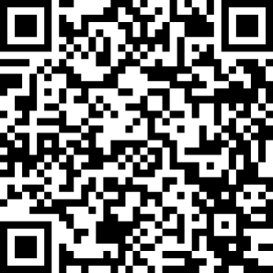

NEC：3D打印
{link}:
Just Scan QR！
KEEP BUILDING█ Design by in CIT
newenergycoder.club

